Slide 1
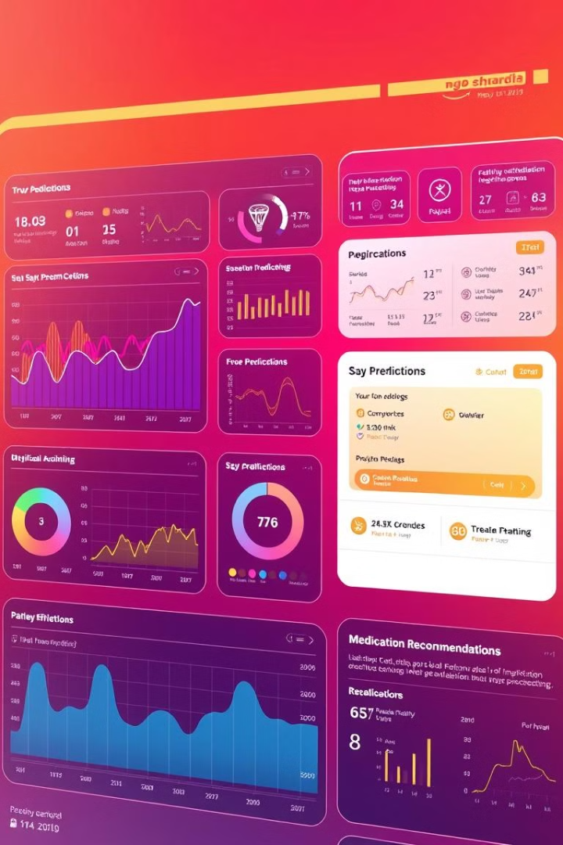
MedSymphony: Harmony Conditions and Prediction System
NAME : RAJARAM S
REGISTER NUMBER : RA2332014010107
DEPARTMENT : M.Sc. APPLIED DATA SCIENCE
COLLEGE : SRM INSTITUTE OF SCIENCE AND TECHNOLOGY

Slide 2

About the Project
"MEDSYMPHONY" combines 'MED' (Medical) and 'SYMPHONY' (harmony), symbolizing a unified healthcare system.
It reflects how different features like symptom analysis, drug reviews, and predictions work together seamlessly.
The name suggests a smooth, coordinated healthcare experience for users.
This project aims to assist patients and healthcare professionals by predicting diseases and suggesting suitable medications using NLP and machine learning.

Slide 3

How It Works
1
Disease Prediction
2
Drug Review Analysis
3
Heart Disease Prediction
Users enter symptoms in text format. The system processes the text using NLP techniques and predicts the most likely condition, providing a list of recommended medications.
The system uses a database of drug reviews to evaluate medication effectiveness, filtering highly rated drugs based on user reviews, ratings, and usefulness count.
Users enter health parameters. The system applies a machine learning model to determine the risk of heart disease and provides preventive recommendations.

Slide 4




Technology Implementation
Frontend
Backend
Database
Developed using HTML, CSS, and JavaScript for an interactive UI.
Powered by Flask (Python) to handle form submissions and requests. Connects with a relational database (SQLite3).
Utilizes SQLite3 to efficiently store and retrieve drug reviews, user inputs, and disease prediction records.

Slide 5


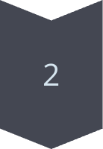
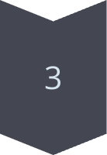
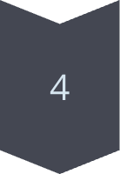
Data Preprocessing Steps
Text Cleaning & Tokenization
Raw textual data cleaned by removing special characters and redundant words. Tokenization applied to split text into meaningful words.
Addressing Missing Values
Dataset examined for missing values, and incomplete entries handled using imputation techniques or removal.
Feature Extraction
Text-based features extracted using TF-IDF and Word Embeddings for meaningful representation in machine learning models.
Feature Normalization
Numerical features normalized to maintain uniformity across different scales and prevent biases in predictions.

Slide 6

Algorithm I have used for Analyzing Drug Reviews
Natural Language Processing (NLP)
🔍 Why?
Drug reviews are in free-text format (like sentences written by patients). Handles large volumes of unstructured text.
NLP helps to analyze, clean, and understand the text so we can use it for predictions or categorization.
🧠 How it works:
Uses steps like tokenization, stopword removal, lemmatization to preprocess the text.
Then transforms the text into numbers using TF-IDF (Term Frequency – Inverse Document Frequency).
These features can then be used in ML models.

Slide 7

Tokenization
What it is: Splits a large piece of text into smaller units like words or sentences.
Why it's used: Computers can't process raw text efficiently. By breaking it down, we make it easier to analyze.
Example: "The medicine works great!" ➝ ["The", "medicine", "works", "great", "!"]

Slide 8

Stopword Removal
What it is: Removes common words like "the", "is", "in", "and", etc., that don’t add much meaning to the context.
Why it's used: Helps focus on important words that actually contribute to understanding the sentiment or condition.
Example: From ["The", "medicine", "works", "great"] ➝ ["medicine", "works", "great"]

Slide 9

Lemmatization
What it is: Reduces words to their base or dictionary form.
Why it's used: To treat words like “running”, “ran”, and “runs” all as “run”, giving better accuracy for text models.
Example: "medications" ➝ "medication" "working" ➝ "work"

Slide 10

TF-IDF (Term Frequency – Inverse Document Frequency)
What it does: Converts text into numerical form, showing how important a word is in a document relative to other documents.
Why it's used: Highlights unique and meaningful words in each review, giving weight to rare but important terms.
How:
TF counts how often a word appears.
IDF reduces the weight of common words across many documents.
Example: If the word "diabetes" appears frequently in one review but rarely elsewhere, it gets a high score.

Slide 11
Summary
Step | Purpose | Output Example
Tokenization | Breaks text into words | ["medicine", "works", "great"]
Stopword Removal | Removes common words | ["medicine", "works", "great"]
Lemmatization | Converts words to base form | ["medicine", "work", "great"]
TF-IDF | Weighs words by importance | [0.3, 0.0, 0.8, 0.0, ...]

Slide 12
How It’s Working ?
Input Review
"It has no side effect, I take it in combination of Bystolic 5 Mg and Fish Oil"
RESULT
Tokenization:
“It”, “has”, “no”, “side”, “effect”, “I”, “take”, “it”, “in”, “combination”, “of”, “Bystolic”, “5”, “Mg”, “and”, “Fish”, “Oil”
Stopword Removal:
“side”, “effect”, “take”, “combination”, “Bystolic”, “5”, “Mg”, “Fish”, “Oil”
Lemmatization:
“side”, “effect”, “take”, “combine”, “Bystolic”, “mg”, “fish”, “oil”
TF-IDF / CountVectorizer Transformation:
Converts the text into a numerical vector based on word importance/frequency
Prediction:
The model associates the processed input with the condition "Left Ventricular Dysfunction"

Slide 13
Heart Disease Prediction
Data Collection & Preprocessing
1
Collect Heart Disease datasets and perform data cleaning using ML techniques.
Datasets info
2
Dataset contains fields like age, sex, chest pain type, cholesterol, fasting blood sugar, etc.
Heart Disease Prediction Module
3
I have used Logistic Regression, Random Forest, KNN, SVM, and XGBoost for Heart Disease Prediction.

Slide 14
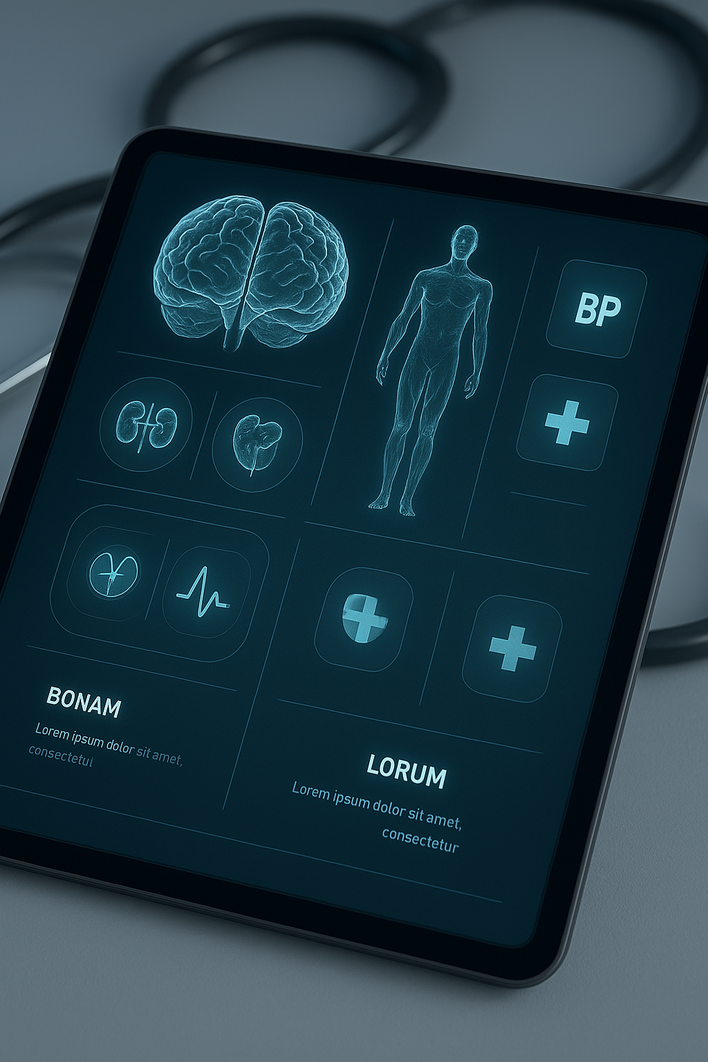
Logistic Regression
📌 Why Used: It’s a simple and effective binary classifier (Yes/No) that predicts whether a person has heart disease or not.
⚙️ How it Works:
Uses input features like age, cholesterol level, blood pressure, etc.
Calculates the probability of heart disease using the logistic (sigmoid) function.
✅ Best For:
Interpretable models
Small to medium datasets

Slide 15

Decision Tree
📌 Why Used: It’s an easy-to-understand and interpretable model that mimics human decision-making for classification.
⚙️ How it Works:
Splits the dataset into branches based on feature conditions (like "Is cholesterol > 200?").
Continues splitting until it reaches a decision leaf (Yes/No for heart disease).
Follows a tree-like structure.
✅ Best For:
Clear, visual understanding of decision paths.
Handling non-linear relationships in the data.
Fast training and prediction on structured data.

Slide 16
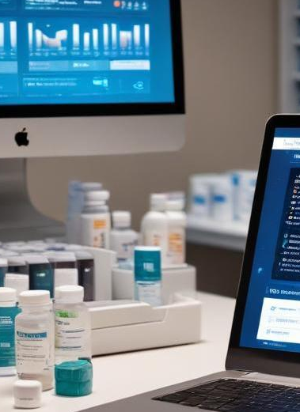
Random Forest
📌 Why Used: It’s a robust ensemble model that reduces overfitting by combining predictions from multiple decision trees.
⚙️ How it Works:
Builds many decision trees on random subsets of the data.
Each tree votes, and the majority vote becomes the final prediction.
✅ Best For:
High accuracy
Handling missing or unbalanced data
Feature importance ranking

Slide 17

K-Nearest Neighbors (KNN)
📌 Why Used: It’s a lazy learning algorithm good for detecting local patterns in smaller datasets.
⚙️ How it Works:
For a new patient, checks the 'K' closest patients (neighbors).
Assigns the most common class (disease/no disease) among them.
✅ Best For:
Simple models
Pattern recognition in localized areas

Slide 18

Support Vector Machine (SVM)
📌 Why Used: Excellent for problems with a clear boundary between two classes (disease / no disease).
⚙️ How it Works:
Finds the best separating line (or hyperplane) between classes.
Can handle non-linear data using kernel tricks.
✅ Best For:
Complex but well-separated data
High-dimensional datasets

Slide 19

XGBoost (Extreme Gradient Boosting)
📌 Why Used: A high-performance boosting algorithm known for top-level prediction accuracy.
⚙️ How it Works:
Builds models sequentially, each improving on the previous one’s errors.
Uses gradient descent to minimize error.
✅ Best For:
Competitive ML challenges
Speed and high performance

Slide 20
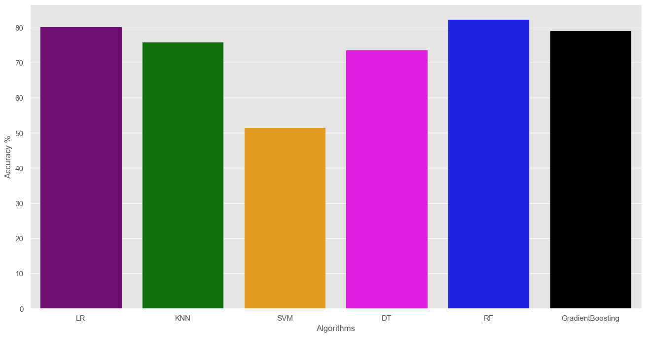
Accuracy and Algorithm

Slide 21




Objectives of the System
Personalized Recommendations
Accurate Disease Prediction
Analyzes user inputs using NLP to predict likely medical conditions.
1
2
Recommends top-rated medications based on patient drug reviews.
Efficient Drug Review Management
User-Friendly Interface
4
Simple UI for easy input, predictions, and drug recommendations.
3
Allows users to add, edit, and browse medication reviews.

Slide 22

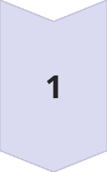
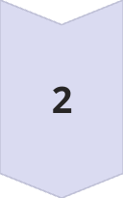
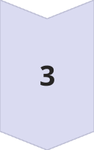
Future Work
Add More Disease Models
Use Deep Learning For Review Analysis
Integrate Chatbot For Health Queries

Slide 23

Conclusion
The Harmony Condition Management System offers an efficient way to manage drug reviews and predict medical conditions.
It simplifies healthcare data handling through a user-friendly desktop interface.
By integrating symptom analysis and review tracking, it supports better decision-making.
This project bridges the gap between technology and healthcare, promoting smarter, accessible patient care.

Slide 24

Thank You, Sir/Ma'am
I would like to extend our heartfelt thanks to you for evaluating my project and presentation.
Your time, attention, and valuable feedback mean a great deal to me.
This project has been a significant learning experience, and your observations will surely help me grow and improve further.
I am truly grateful for your presence and encouragement.
Thank you once again.
Respectfully, Rajaram S

